Slide 1
Hugging Face Fundamentals for Machine Learning
Hugging Face Fundamentals for Machine Learning
Delivered by: Noureddin Sadawi, PhD

Slide 2



About the Speaker
Name: Dr Noureddin Sadawi
Academic Qualification: PhD Computer Science
Experience: Several areas including but not limited to Docker, Machine Learning and Data Science, Python and more.
Machine Learning Specialty

Slide 3
Python Code
All Python code is available here: https://github.com/nsadawi/huggingface-course

Slide 4
What is HuggingFace?
HuggingFace is a prominent platform in the artificial intelligence and machine learning community.
Founded in 2016, HuggingFace offers a comprehensive suite of tools and resources designed to facilitate the development and deployment of machine learning models.
It is is a platform where the ML community collaborates on models, datasets, and applications.
Website: https://huggingface.co/

Slide 5
Core of HF
Models
Datasets
Spaces
Open Source Libraries and Docs Community

Slide 6
HF Models
Hugging Face hosts many open-source models, such as LLMs, diffusion based text-to-image models, audio models, and much more!
A key advantage of using Hugging Face for this is their CLI tool, which is designed for large model files.
Model pages can also include lots of useful tools and information.
Some models will have direct links to run inference or host the model on a space.
Keep in mind, not all model pages are created equally, since any one can post a model, there could be some models that aren’t well documented.

Slide 7
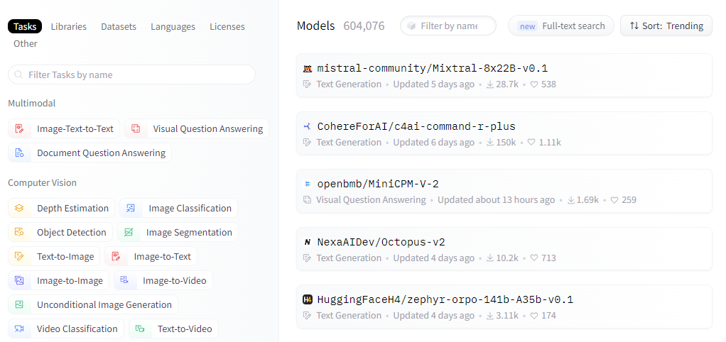
HF Models

Slide 8
HF Datasets
Similar to Models, Hugging Face also hosts datasets for training and evaluation.
This can include text data sets, audio data, image data, and more!
Not all datasets or models are immediately available! You may need to request permission to access the model.
For example, some voice cloning models requires an application process, this is known as a “gated” model.

Slide 9
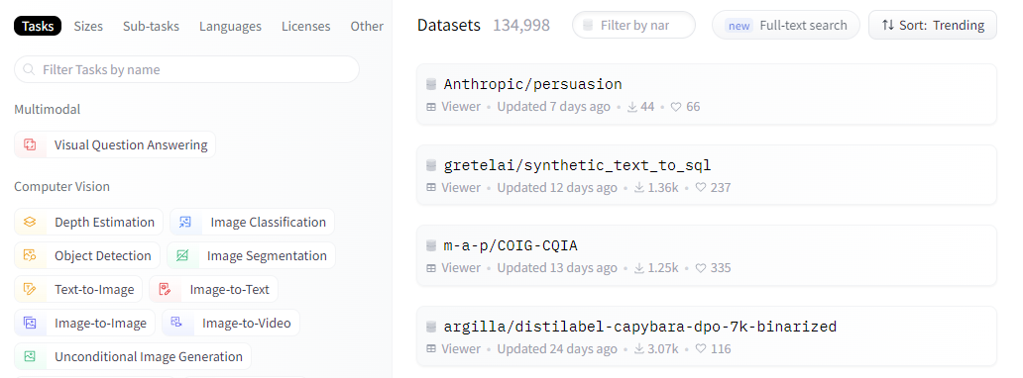
HF Datasets

Slide 10
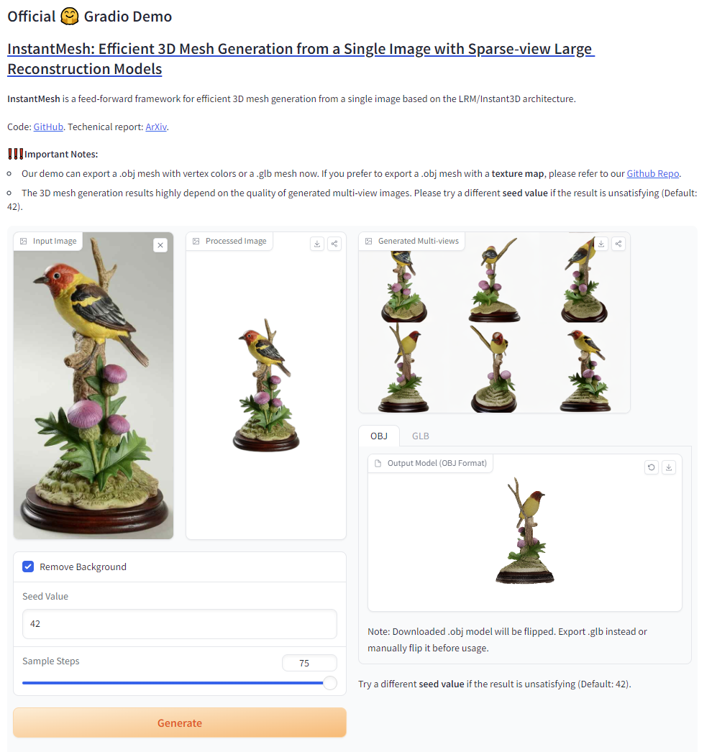
HF Spaces
Spaces allows you to easily create a git repository and connect it to hardware compute resources to allow people to use your ML applications on the web.
Often these are used to share demos with the ML community using open-source libraries, such as Gradio.

Slide 11
Open Source Libraries
Hugging Face creates, manages and documents many open source libraries that are popular the ML space, such as:
Transformers
Diffusers
Gradio
Accelerate
Many more!

Slide 12
Open Source Libraries
Transformers: Helps you run pretrained transformers models (most often LLMs or Text models).
Diffusers: Meant for diffusion based models (often Text-to-Image models).
Gradio: Easily create GUIs for ML applications, often used in HF Spaces.

Slide 13
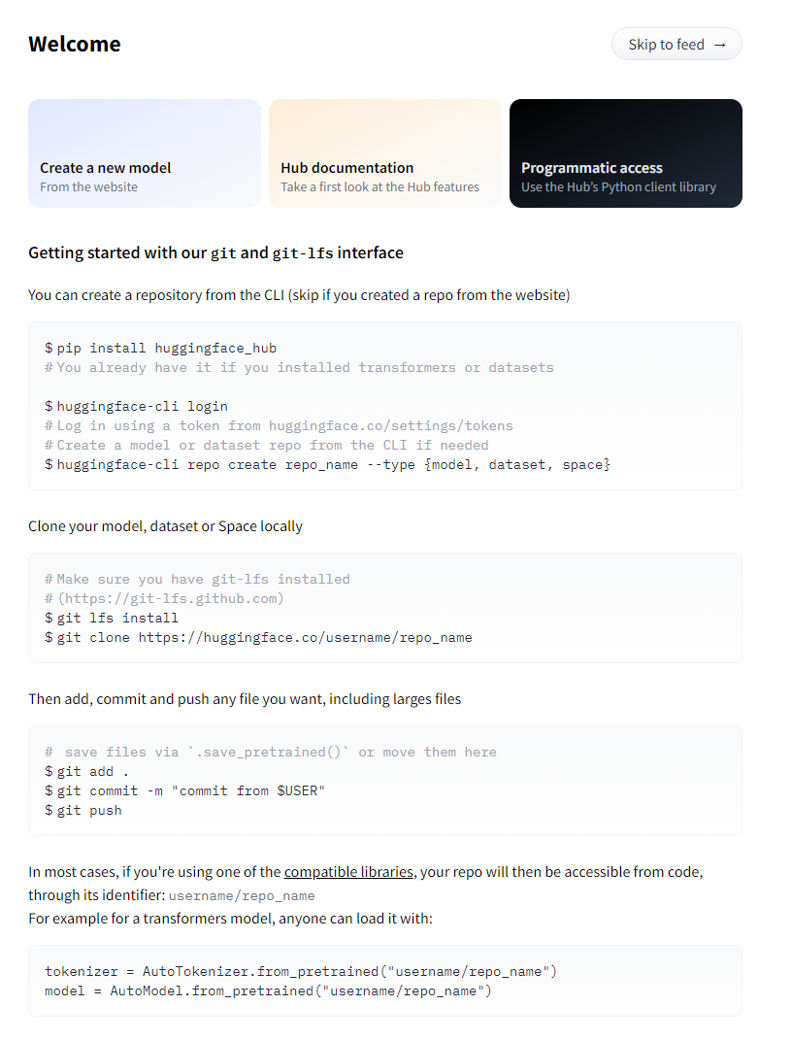
Sign up
Creating a Hugging Face account is straightforward, simply go to:
https://huggingface.co
Then select “Sign Up” on the top navigation bar and provide an email address.
Upon creating a new account you will see

Slide 14
Note
To fully utilize a Hugging Face model repository, you should already have an understanding of git and have it installed at your computer.
You can install it from: https://git-scm.com/
For useful information on how to set your HF token with git, check out: https://huggingface.co/blog/password-git-deprecation

Slide 15
Hands-on
Let’s do the following:
Create an Account
Create a new Model repository
Create a new Hugging Face Token
Clone the repository locally using an Hugging Face Token
Add files locally
Push our changes to Hugging Face

Slide 16
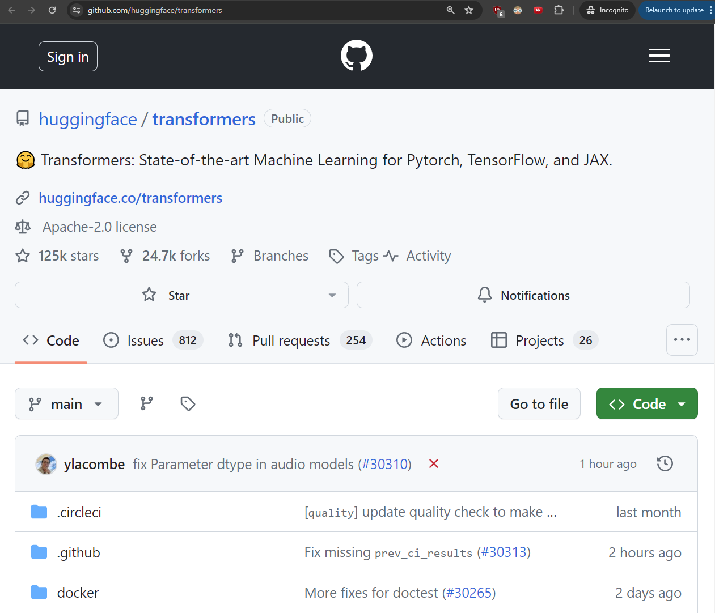
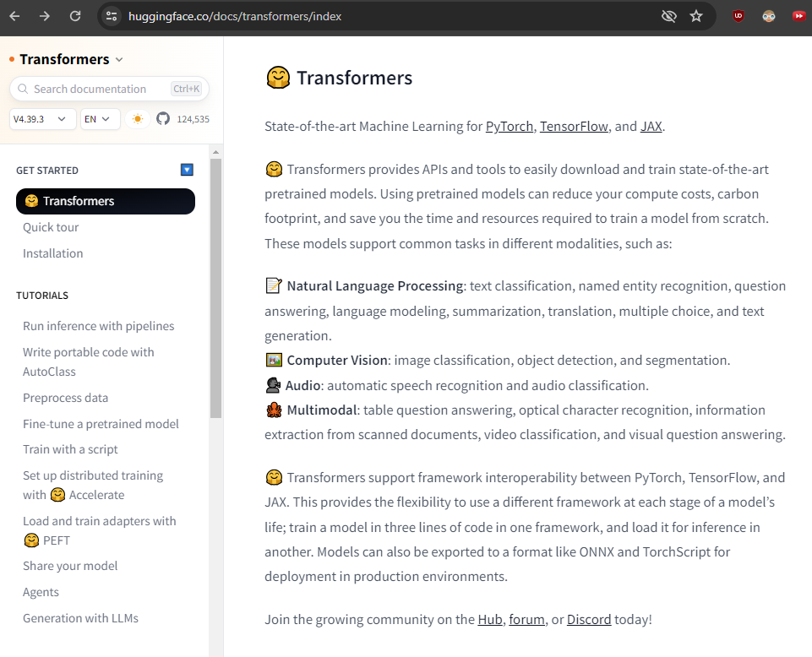
Open Source Libraries and Docs
Python implementation is on github and models and their docs are on HF.

Slide 17
Hands-on
Let’s get started and get you setup:
Connect to an online notebook.
https://colab.research.google.com/
Connect to a GPU instance.
Install a new library inside a cell.
Connect to Hugging Face Hub.
Upgrade/Downgrade libraries inside a cell.

Slide 18
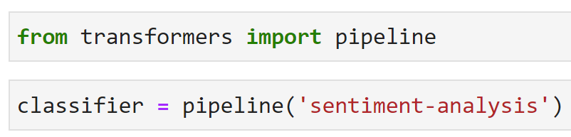
Library Updates
HF libraries are updated really often.
New versions add new capabilities, such as “text-translation” when a new model is uploaded to Hugging Face.
This usually does not break old code that is simply calling a pipeline.
Due to the pipeline nature of these libraries, most of these upgrades simply involve adding a new model capability to the pipeline.

Slide 19
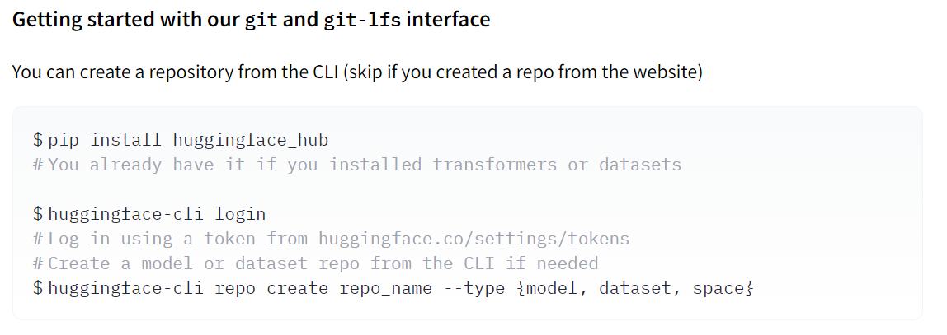
The CLI
Note to use the CLI, you will need a token:

Slide 20
Text Models
Text Models: Models designed to take in natural language text as input.
The transformers library from HF:
A pipeline based library that allows you to easily load models from Hugging Face!

Slide 21
Now we will have
Hugging Face Basics:
Introduce transformers and datasets.
Pipelines for NLP Tasks:
Explore a variety of transformers library based pipelines.
LLM Deep:
Dive Explore both the theory and practice of how to use LLMs.

Slide 22
Now we will have
Let’s use the datasets library to load in a dataset of movie reviews directly from Hugging Face and then a transformers pipeline to perform sentiment analysis on these reviews.
Demo: The HF-Basics Jupyter Notebook

Slide 23
Large Language Models (LLMs)
Let’s go over how an LLM works from a very high level overview, note that we are discussing inference in this lecture, not training.
Having a basic understanding of how the model works will help you understand the generation configuration parameters we’ll cover later on in the course!

Slide 24
NLP Demo
Demo: The Pipelines-for-NLP-Tasks Jupyter Notebook

Slide 25
Large Language Models (LLMs)
LLM
What is the capital of France?
Paris

Slide 26
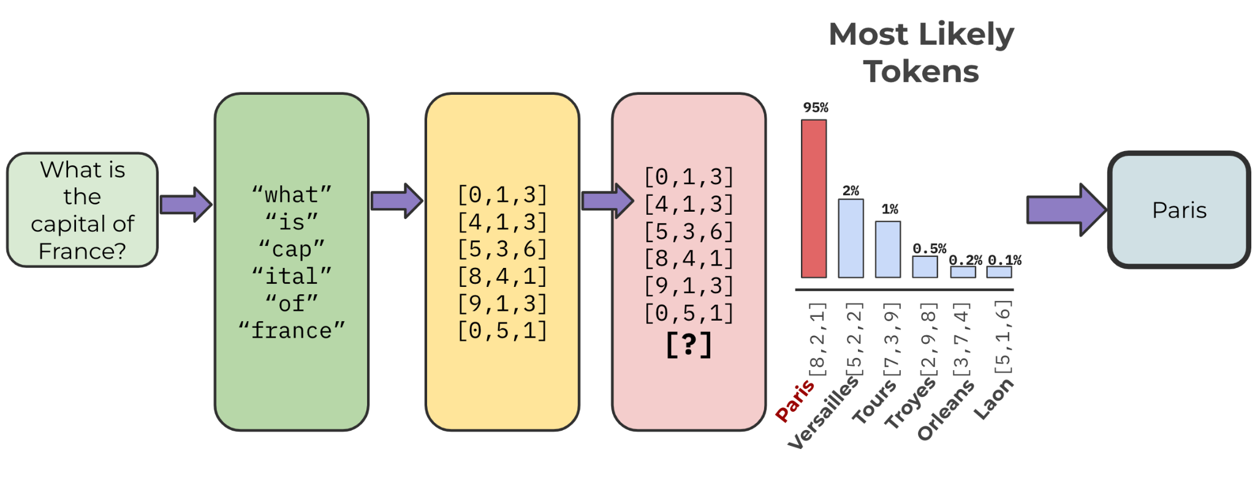
Large Language Models (LLMs)

Slide 27
Tokens
Model uses tokens, not words.
Model has its own internal vector embedding representation of tokens.
The next most probable token is chosen from a distribution, allowing for stochastic results (next token is not deterministic, even for the exact same input).

Slide 28
Model Temperature
The term temperature comes from statistical thermodynamics.
You can think of this as effecting the sampling of the distribution of tokens.
Lower temperatures will cause the model sample the most likely tokens while a higher temperature will push the model to sample less likely tokens.
Higher Temperature (~1.0): More “creative” results, could sometimes go off topic or random.
Lower Temperature (~0.0): Less “creative” results, should be used in situations where you expect a singular correct answer.

Slide 29
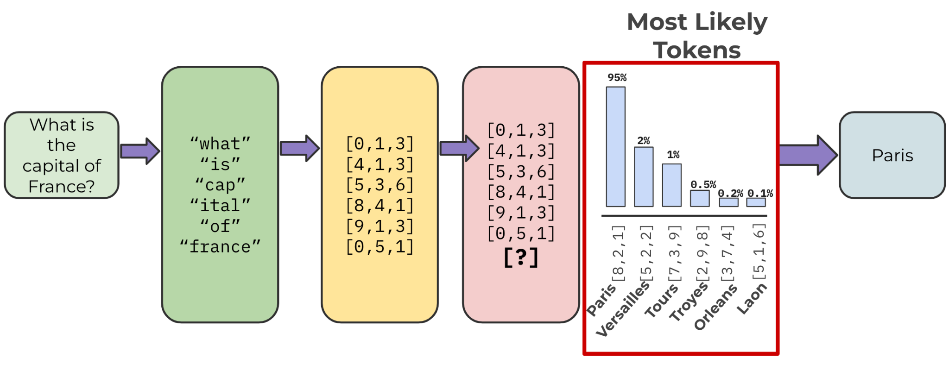
LLM Probabilities

Slide 30
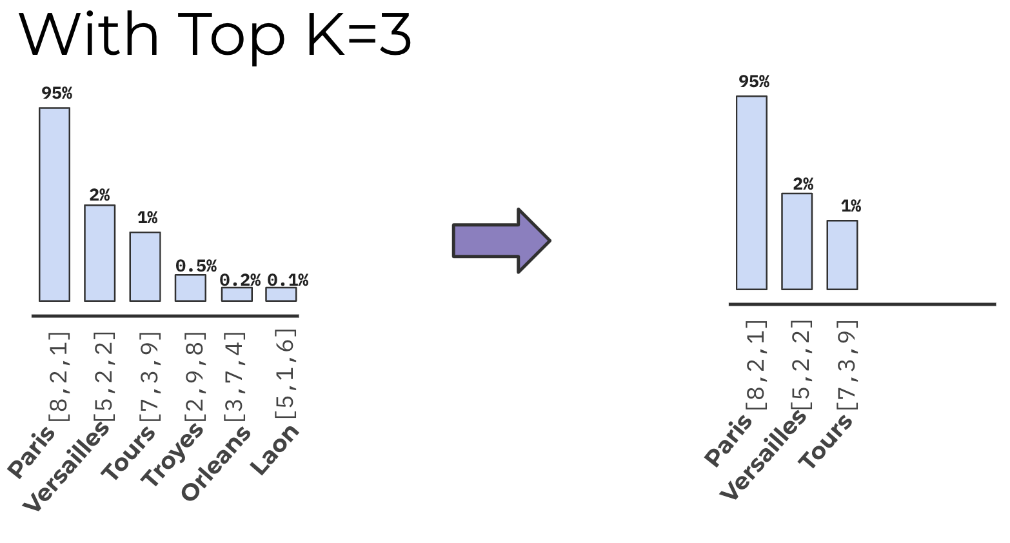
LLM Probabilities: Top K
This means you would only consider the top K amount of tokens before the model conducts the probabilistic sampling.
For example, if K=3, you would only consider the 3 most likely tokens before you sample.

Slide 31
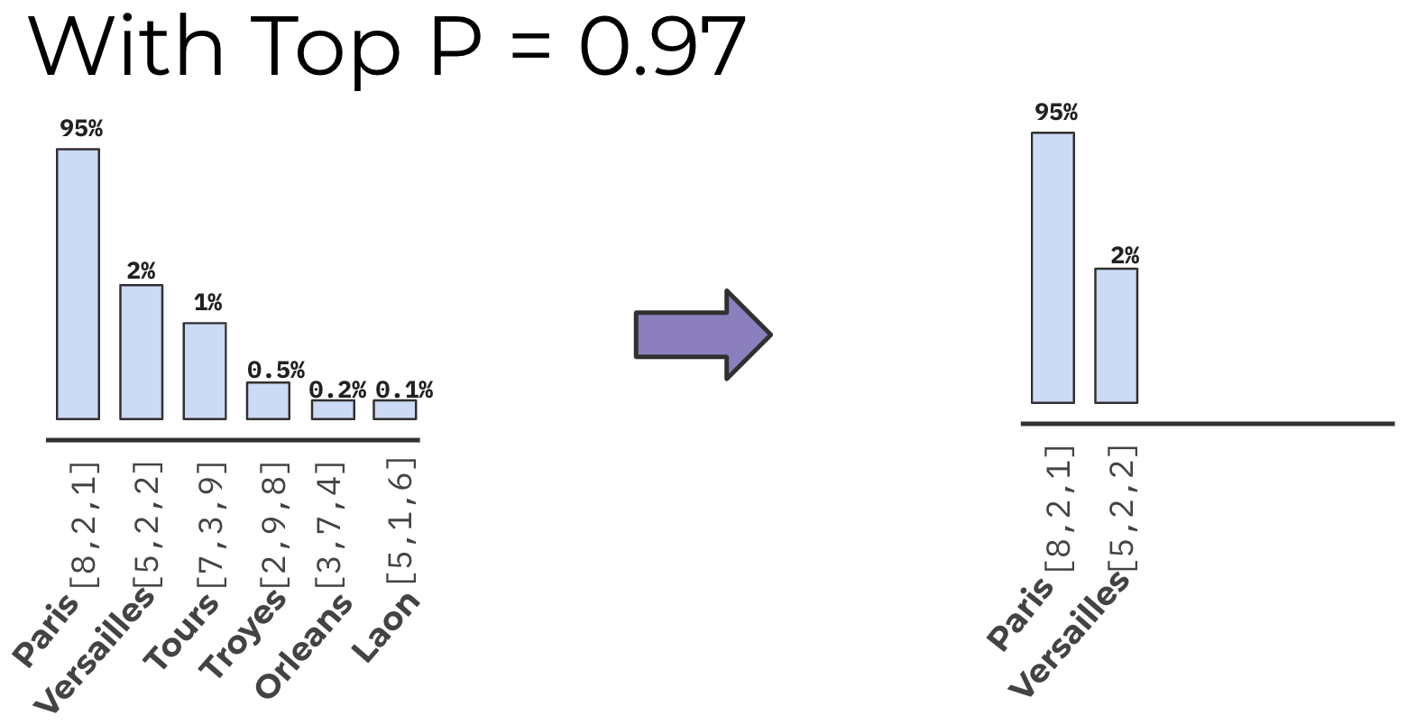
LLM Probabilities: Top P
This considers the cumulative probability of the tokens, allowing you to cut-off at a certain cumulative probability.
For example, a P = 0.97 would stop considering any tokens once the cumulative probability reaches 97%.

Slide 32
LLM Hands-on
Let’s explore an open-sourced LLM GPT-2, which should be small enough to run on a relatively powerful computer yet give results that are coherent.
We’ll breakdown many of the steps we just went over in this theoretical overview!
Demo: The LLMs Jupyter Notebook

Slide 33
End of Part 1

Slide 34
Diffusers and Image Models
Image Data Overview
Image Data with Python
Understanding Text to Image Models
Diffusion Models with Python
AutoPipelines with Diffusers

Slide 35
Image Data
Let’s imagine we have a simple image of a handwritten number:

Slide 36
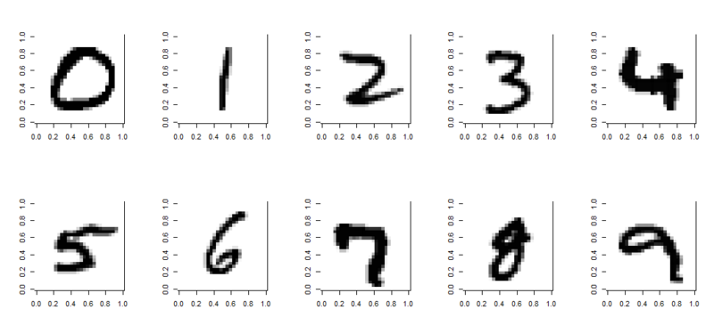
Image Data
Each single digit image can be represented as an array

Slide 37
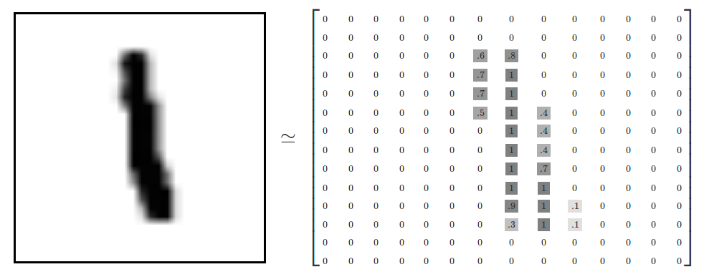
Image Data
For example, here a number is 28 by 28 pixels
A Nice Demo: https://setosa.io/ev/image-kernels/

Slide 38
Grayscale Images
Then how dark a pixel should be can be represented as a value between 0 and 1.
Often the default images have values between 0 and 255.
The range 0 to 255 has to do with how computers store 8-bit numbers.
But you can always divide all the values by 255 to normalize to between 0 and 1.

Slide 39
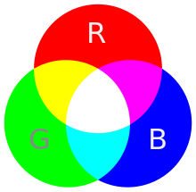
Color Images
Now that we’ve understood how grayscale images can be represented as arrays, what about color images?
Color images can be represented as a combination of Red, Green, and Blue.
Additive color mixing allows us to represent a wide variety of colors by simply combining different amounts or R, G, B.

Slide 40
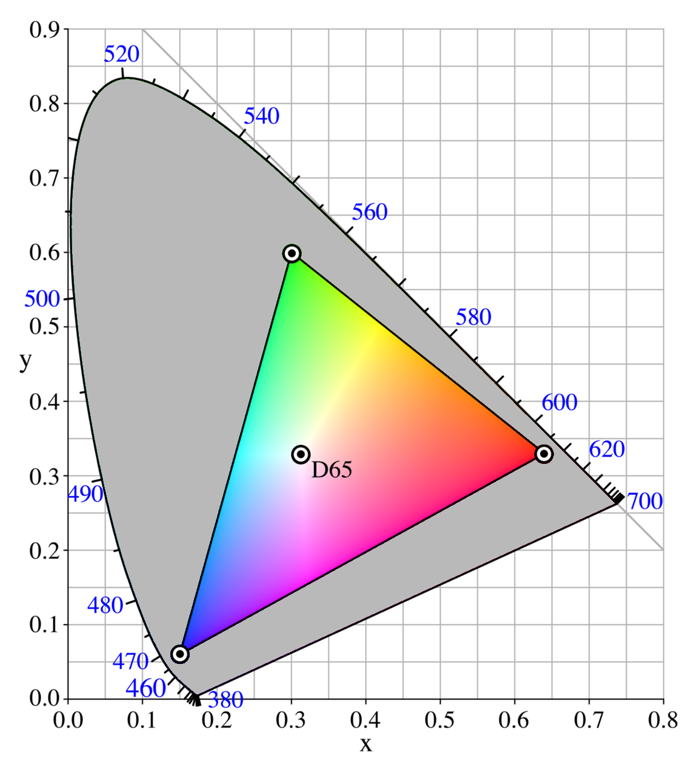
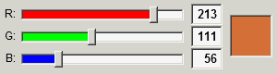
Color Images
RGB allows to produce a range of colors.
Each color channel will have intensity values.
You may have already seen this sort of representation in other software with RGB sliders.

Slide 41
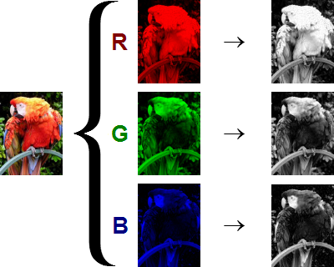
Color Images
The shape of the color array then has 3 dimensions:
Height
Width
Color Channels

Slide 42
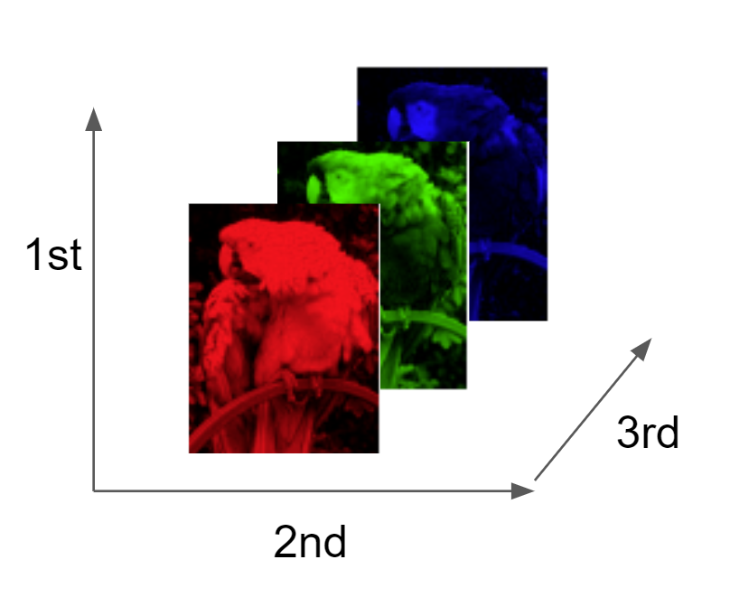
Color Images
This means when you read in an image and check its shape, it will look something like:
(1280,720,3)
1280 pixel width
720 pixel height
3 color channels

Slide 43
Demo
Demo: The Understanding-Image-Data Jupyter Notebook

Slide 44
The Diffusers Library
Let’s explore the diffusers library that allows us to easily interact with diffusion based text to image models.

Slide 45
Image Models
Before we dive into the details of how we can generate images with diffusion models and the diffusers library, let’s get a very high-level understanding of how these models actually work.
We’ll base our discussion on the original diffusion techniques popularized by OpenAI’s Dall-E and Stable Diffusion.
Stable Diffusion (2022-08), released by Stability AI, consists of a denoising latent diffusion model (860 million parameters), a VAE, and a text encoder.
The denoising network was a U-Net, with cross-attention blocks to allow for conditional image generation.

Slide 46
Image Models
Stable Diffusion 3 changed the latent diffusion model from the UNet to a Transformer model, and so it is a DiT.
It uses rectified flow.
As of this course the model weights have not been open-sourced.

Slide 47
Diffusion Models
Fundamentally, all a diffusion model does is take in an input text string and output an image.
Note how overall this idea is actually quite similar to the idea of text to text generation, except in this case the modality of the output is different.
Also note how the training data will need to be different!
In order to create images from text, we will need images that have text labels.
Depending on the resources available, we could use existing data sets, create our own, or use deep learning to label images.

Slide 48
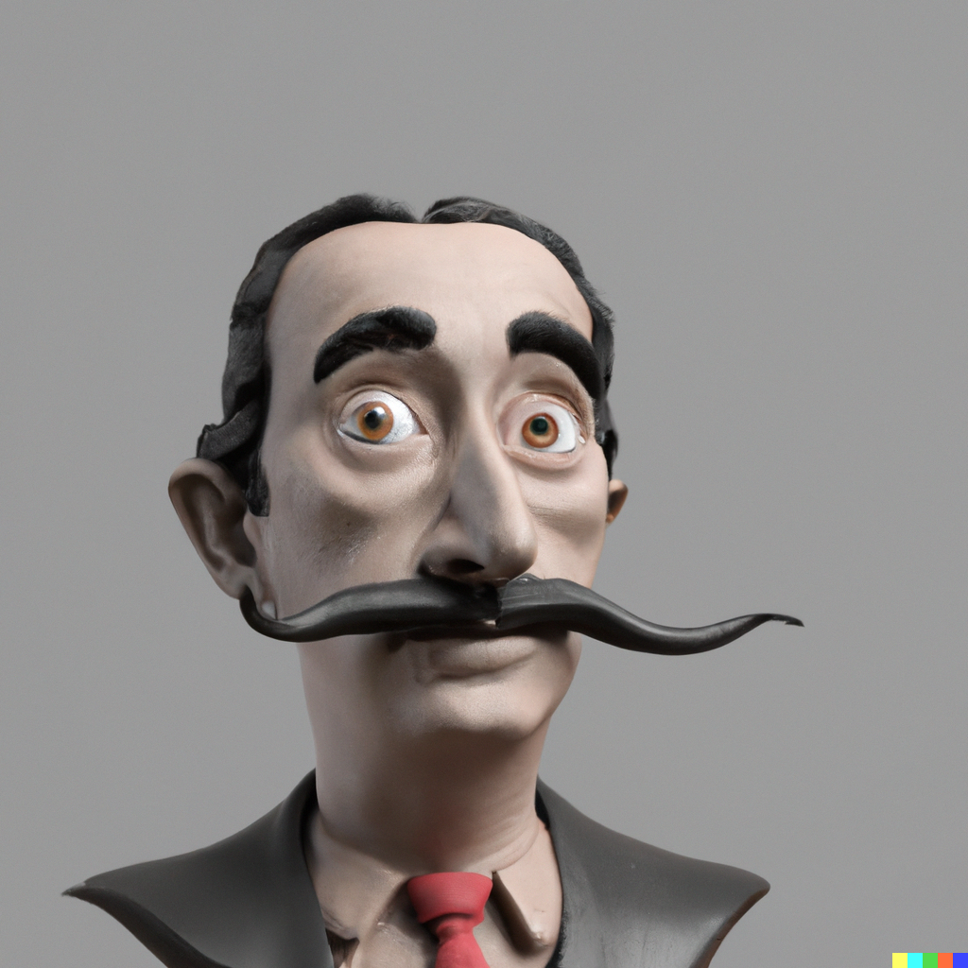
What Diffusion Models do!
Diffusion
Model
“A 3d clay render of Salvador Dali”

Slide 49
Remember!
An embedding is the creation of a vector representation of an object, such as a text embedding, allowing us to represent a word as a vector of N-dimensions.
Essentially, diffusion models understand the relationship between text and images and decode a noisy image to a true image.

Slide 50
Two Stages in these sort of Models
Prior:
Performs the text embedding, generating a CLIP image embedding.
Decoder (unCLIP):
A diffusion model which actually generates the image from the prior embedding.

Slide 51
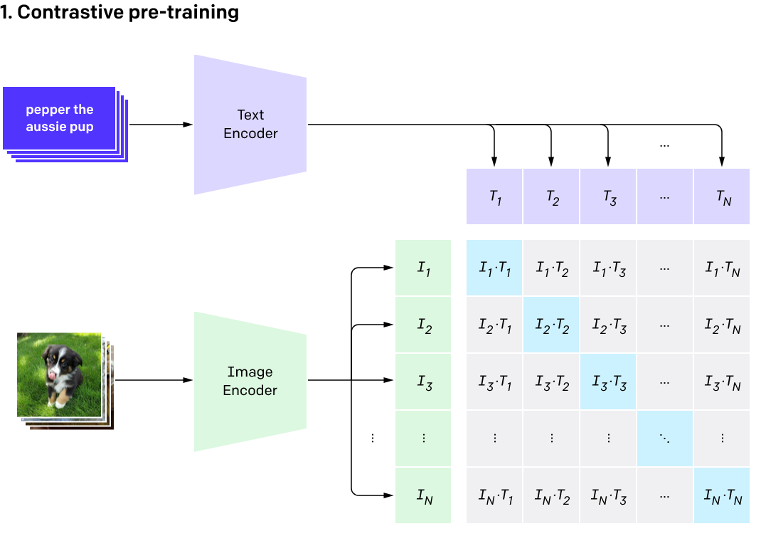
Contrastive Language–Image Pre-training
CLIP is trained on image-text pairs:

Slide 52
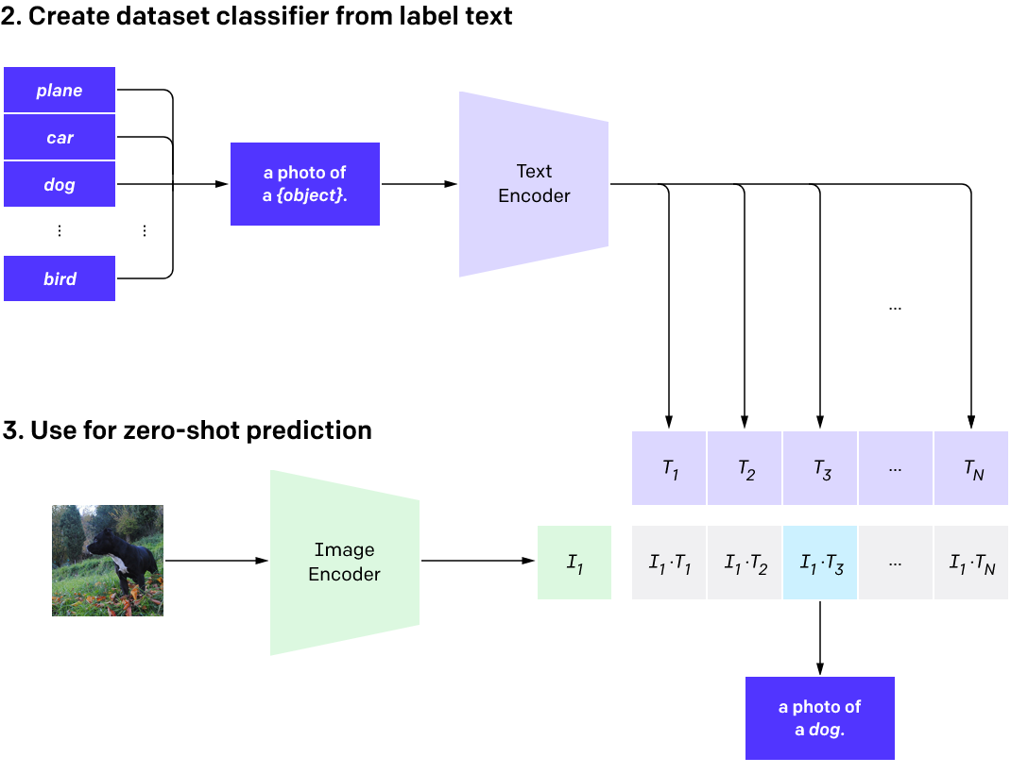
Contrastive Language–Image Pre-training
CLIP is trained on image-text pairs:

Slide 53
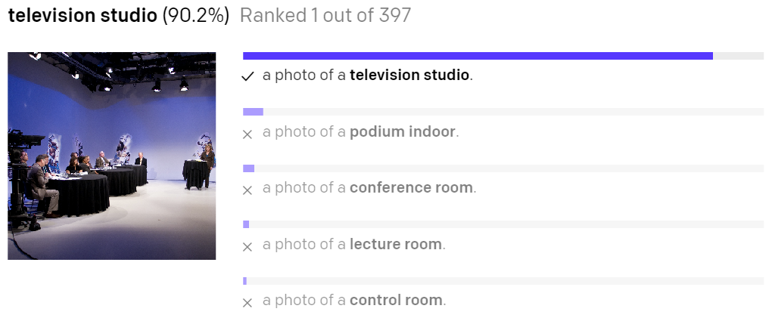
Contrastive Language–Image Pre-training
CLIP is trained on image-text pairs:

Slide 54
CLIP
CLIP is only incentivized to learn the features of an image that are sufficient to match it up with the correct caption (as opposed to any of the others in the list).
This makes CLIP not ideal for learning about certain aspects of images, like relative positions of objects.

Slide 55
Example feature importance plots
Text Embedding
Image
Embedding
“A 3d clay render of Salvador Dali”
Prior
Decoder

Slide 56
Only Text Embeddings?
Why not just pass text embedding?
If you read the publication papers for Dall-E and Stable Diffusion, you will notice the authors were curious to see what happened when attempting to just directly pass the text embedding directly to the encoder.

Slide 57
Instead of doing this:
Text Embedding
Image
Embedding
“A 3d clay render of Salvador Dali”
Prior
Decoder

Slide 58
Why not do this?
Text Embedding
“A 3d clay render of Salvador Dali”
Decoder

Slide 59
Only Text Embeddings?
The authors noted much better results when using the additional Prior model using CLIP.
Intuitively, we can think of this as having one embedding for text meaning, and another embedding for the “gist” of an image from text.
An infinite number of images could be consistent with a given caption, so the outputs of the two encoders will not perfectly coincide.
Hence, a separate prior model is needed to “translate” the text embedding into an image embedding that could plausibly match it.

Slide 60
Diffusion
A diffusion model is trained to undo the steps of a fixed corruption process.
Each step of the corruption process adds a small amount of gaussian noise to an image, which erases some of the information in it.
After the final step, the image becomes indistinguishable from pure noise.
The diffusion model is trained to reverse this process, and in doing so learns to regenerate what might have been erased in each step.

Slide 61

Generating a New Image with a Diffusion Model

Slide 62
Diffusion
Prior Stage:
Generates the CLIP image embedding (intended to describe the “gist” of the image) from the given caption (which itself is actually a text embedding).
Decoder Stage:
A diffusion model called unCLIP generates the image itself from this embedding.
unCLIP receives both a corrupted version of the image it is trained to reconstruct, as well as the CLIP image embedding of the clean image.

Slide 63
Dall-E and Stable Diffusion
After these two stages an upsampling is performed on the image to get higher resolution.
Dall-E 2 and Stable Diffusion 1.5 were trained on 512x512 images, so any higher resolution output is actually upscaled from 512x512.
The latest models are actually trained on larger images such as 1024x1024 pixels (needing much more compute!) and can even upscale much larger than this.
This is one of the fastest moving spaces in Generative AI, so keep tuned on Hugging Face for the latest in image generation!

Slide 64
Demo 1
Now that we understand the high level theory of text to image models, let’s explore these steps with Python and the diffusers library.
Later on in the course we’ll explore how we can expand these image models to generate video by generating “frames” of multiple images and linking them together.
The Understanding-Diffusion-Models Jupyter Notebook.

Slide 65
Extra Demo 2 (time permitting!)
See this tutorial: https://huggingface.co/docs/diffusers/en/tutorials/autopipeline
The AutoPipelines-Diffusers Jupyter Notebook.

Slide 66
End of Part 2

Slide 67
Video Models
One of the latest advancements in generative models has been the development of video models, allowing us to generate video from a single image or a text prompt.
One of the most popular models in this space that is open-source is Stable Diffusion Video.
Most of these models work the same way, they generate a series of images that (hopefully and with good data and good training) imitate the frames of a video, creating a series of images that would work well when formatted together to create a video.

Slide 68
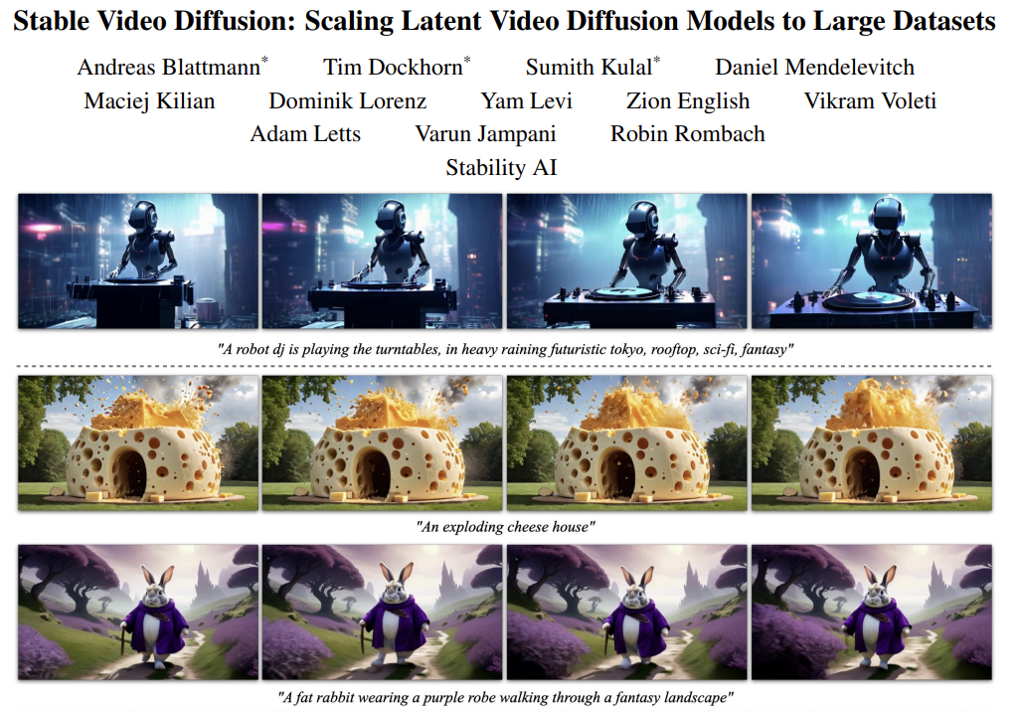
Stable Video Diffusion

Slide 69
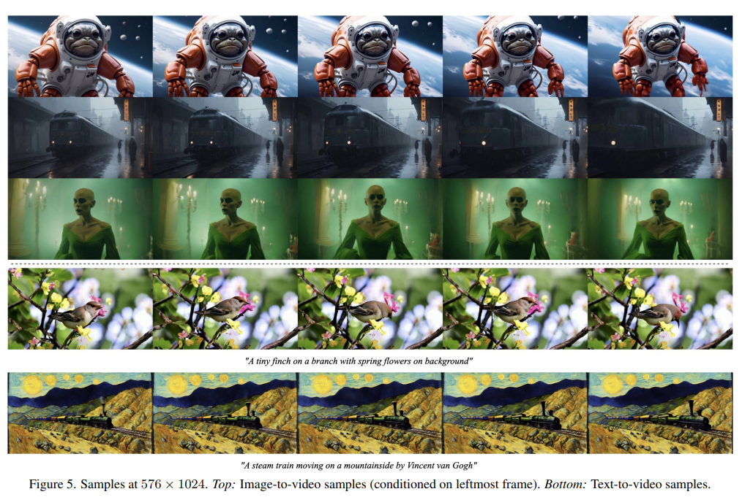
Stable Video Diffusion

Slide 70
How the Model Works
Training Process:
Text-to-Image Pretraining
Video Pretraining High-Quality
Video Finetuning
How the Model Works:
Latent Space Representation
Temporal Layers and Attention Mechanisms
Data Curation and Filtering
Fine-Grained Conditioning

Slide 71
Text-to-Image Pretraining
The initial stage involves training a text-to-image diffusion model.
This model learns to generate images from text descriptions, forming a strong visual representation.
The Stable Diffusion 2.1 model is often used for this purpose.
This model is trained on large-scale image datasets to understand how to convert textual descriptions into corresponding images.

Slide 72
Video Pretraining
Once the text-to-image model is well-trained, it is adapted for video generation.
This adaptation involves inserting temporal layers into the model architecture, enabling it to handle sequences of frames (videos) rather than single images.
Video pretraining is done on large, curated datasets of low-resolution videos.
The dataset used in this paper is called the Large Video Dataset (LVD), which consists of 580 million annotated video clips.
The goal is to teach the model the basics of video dynamics, such as motion and temporal coherence.

Slide 73
High Quality Video Finetuning
After the initial video pretraining, the model undergoes finetuning on a smaller set of high-quality videos at higher resolutions.
This stage refines the model’s ability to generate visually appealing and coherent high-resolution videos.
The finetuning dataset includes videos with rich motion and high aesthetic value, ensuring the model produces high-quality outputs.

Slide 74
How the Model Works
Latent Space Representation
Temporal Layers and Attention Mechanisms
Data Curation and Filtering
Fine-Grained Conditioning

Slide 75
Latent Space Representation
The Stable Video Diffusion Model operates in a latent space, which means it generates compressed representations of video frames.
This approach reduces computational complexity while maintaining high-quality outputs.
Latent space models learn to generate intermediate representations that are later decoded into full-resolution frames.

Slide 76
Temporal Layers and Attention Mechanisms
The model architecture includes temporal convolution and attention layers added to the pretrained spatial layers.
These temporal layers allow the model to understand and generate the flow of motion across frames.
Attention mechanisms help the model focus on relevant parts of the video frames, ensuring coherence and consistency.

Slide 77
Data Curation and Filtering
Data curation plays a critical role in the model’s success.
The training dataset is meticulously curated to remove static scenes, clips with excessive text, and low-quality videos.
Techniques like optical flow analysis and optical character recognition (OCR) are used for this filtering.
The curated dataset ensures that the model learns from high-quality and diverse examples, leading to better generalization and performance.

Slide 78
Fine Grained Conditioning
The model can be conditioned on various inputs, such as text descriptions or single images. For example, in image-to-video generation, the model takes a single frame as input and generates a sequence of frames that follow logically from the input image.

Slide 79
Demos
In this section of the course we’ll explore how we can easily use these models with a pipeline and we’ll also explore another video generation model called I2VGen-XL.
Keep in mind that these will be some of the most compute and memory heavy models we use in the course!

Slide 80
Demo Stable Diffusion Model
The Stable-Video-Diffusion Jupyter Notebook.

Slide 81
I2VGen-XL Model
Unlike Stable Video Diffusion, we can also add a text prompt along with an image to attempt to help guide the model to a particular output.
The Image2VideoGen-XL Jupyter Notebook.

Slide 82
Audio Data
Audio data has a few key features we need to discuss before we can begin using it in machine learning applications.
We need to understand:
Frequency and Sound
Amplitude and Bit Depth
Waves
Frequency
Spectrograms

Slide 83
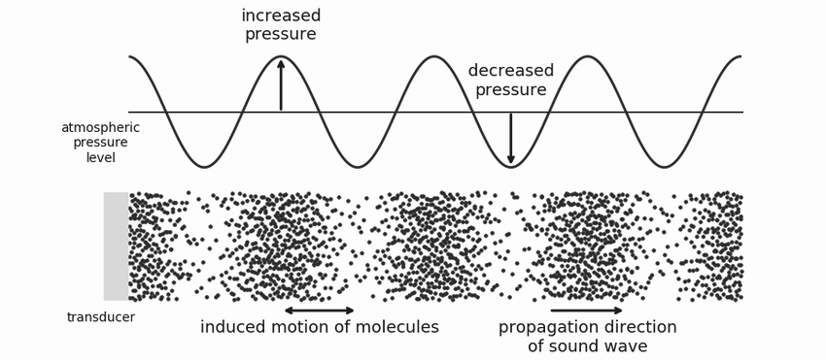
Sound Waves
Sound waves are when matter is vibrating, which transports energy through the medium.

Slide 84
Sound Waves
From a typical human perspective, we would think of this as air molecules at different pressures.

Slide 85
Sound Waves
However, keep in mind that sound can travel through many mediums, for example when you hear sounds underwater.

Slide 86
Frequency
When recording sound, we have to choose a sampling rate (frequency), which is how often we are recording the changes in vibration.
We sample in hertz (Hz), which is a measurements per second, so 1 kHz is 1000 samples a second.
Typically, audio is sampled at 16 kHz, 44.1 kHz, or 192 kHz.

Slide 87
Audio Machine Learning
When working with audio machine learning models, we often need to make sure the data we are using is at the same sampling rate that the model was trained on.
ML models often use 16 kHz, since it balances data size with information signal, but it really depends on the model and domain.

Slide 88
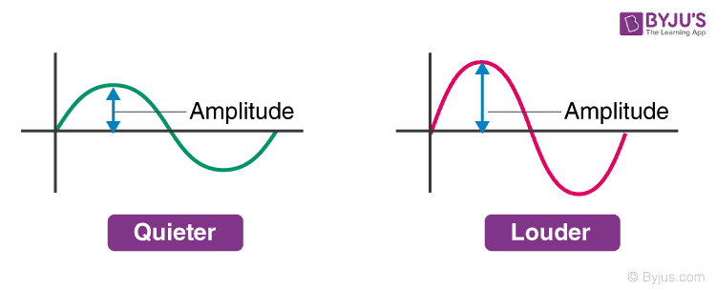
Amplitude
Describes sound pressure level at any given instant, measured in decibels (dB).
Perceived as loudness.

Slide 89
Amplitude in Digital Audio vs “Real World”
Expressed in decibels (dB) like continuous audio signals.
Human hearing is logarithmic; easier to interpret loudness in decibels.
For real-world audio: 0 dB = quietest sound, higher values = louder sounds.
For digital audio: 0 dB = loudest possible amplitude, other amplitudes are negative.
Rule of thumb: every -6 dB is a halving of amplitude, below -60 dB is generally inaudible unless volume is increased significantly.

Slide 90
Digital Audio Samples
Each sample records the amplitude of the audio wave at a specific point in time.
Bit depth determines the precision of this amplitude value.
Higher bit depth = more accurate digital representation of the original sound wave.
16-bit audio: 65,536 possible amplitude values.
24-bit audio: 16,777,216 possible amplitude values.
Higher bit depth reduces quantization noise (introduced by rounding continuous values to discrete values).

Slide 91
Visualising Audio
Waveforms over time
Frequency Spectrum
Spectrograms

Slide 92
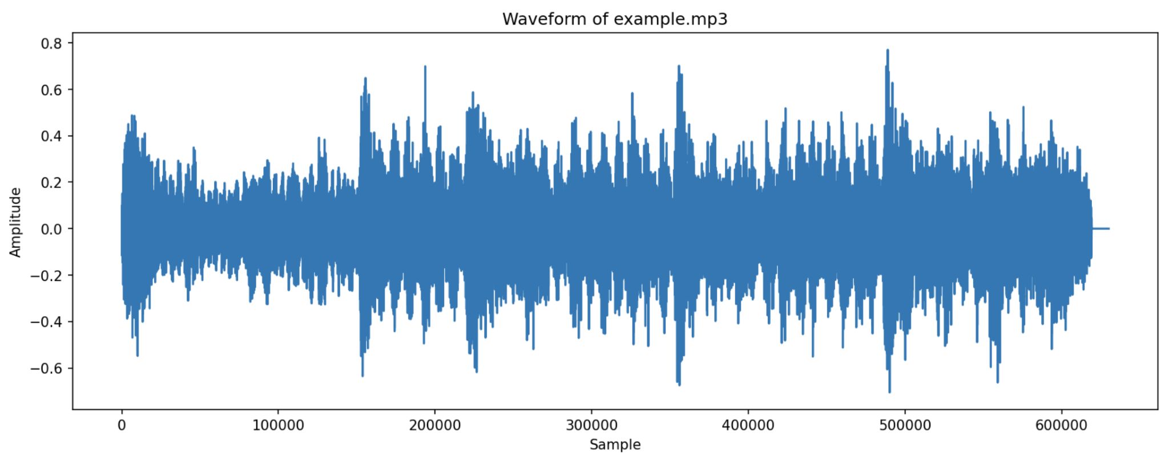
Waveform

Slide 93
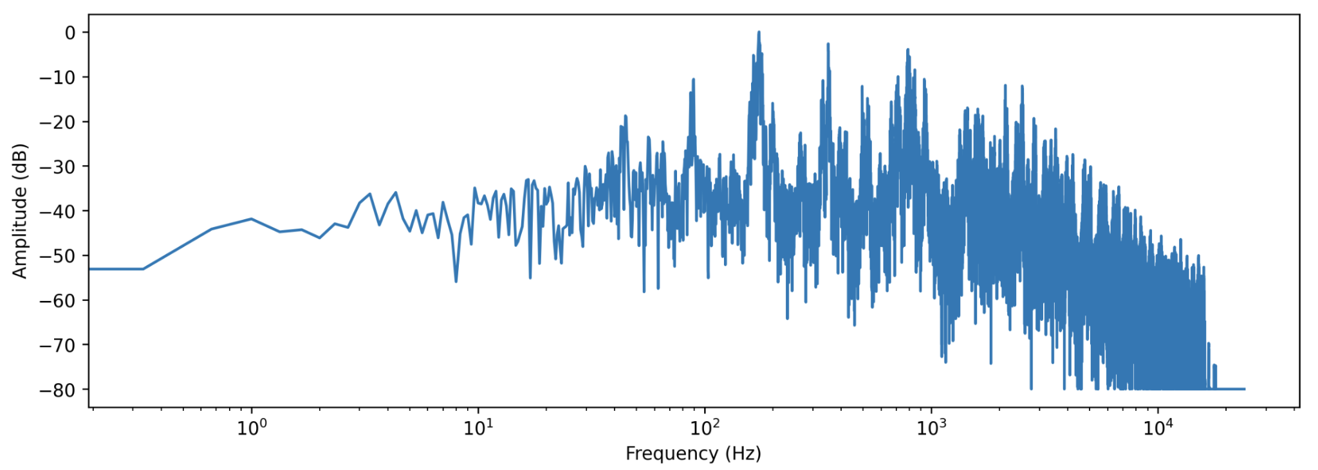
Frequency Spectrum

Slide 94
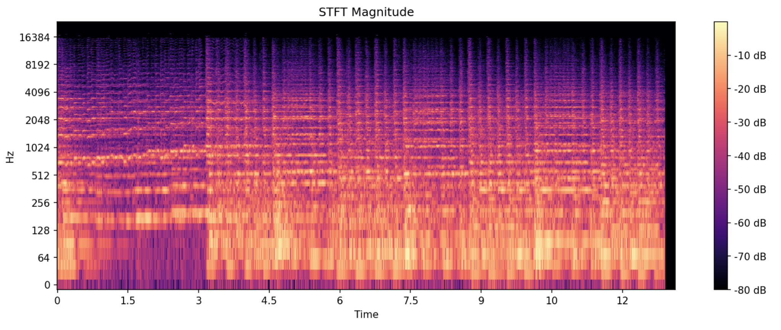
Spectrogram

Slide 95
Demo: Audio data with Python
Let’s explore how to open and visualise audio data in Python.
To do this, we’ll be using the python library librosa.
I have included a 4-second long audio file called example.mp3 of myself saying “The quick brown fox jumps over the lazy dog”.
The Audio-Data Jupyter Notebook.

Slide 96
Audio Classification
Hugging Face offers many open-source models that can classify audio into a variety of categories.
An example is classifying emotions of a voice.
Keep in mind that for most tasks, you’ll need to find a model that has relevant classification categories if you do not want to fine-tune your own model.
Fortunately there are already many available, everything from bird sound classifications to english accent classification.

Slide 97
Audio Classification
We can easily use these models via the transformers libraries, allowing us to separate the preprocessing from the model prediction.
Alternatively we can load models into a pipeline and achieve the final classification result with a single call to the model while providing the raw audio.

Slide 98
Important Note
Many of the audio based models and pipelines require torch, torchaudio, and transformers.
Make sure when installing these libraries that you are using versions that are compatible with each other.
Sometimes torch and torchaudio latest versions are a step ahead of what is compatible with the latest transformers.
Also transformer versions of pipelines that work for certain models (such as Stable Diffusion Video) sometimes need to be downgraded or upgraded to work with audio based pipelines.
Pay careful attention to versions and error codes when switching ML tasks!

Slide 99
Demo: Audio Classification
The Audio-Classification Jupyter Notebook.

Slide 100
Audio Transcription
A common use case for audio based machine learning models is to transcribe human speech.
Another use case is to detect different speakers during a conversation, this is known as diarization.
To create a time-stamped transcription of a conversation, we need both these capabilities.

Slide 101
Diarisation and Transcription
Here we will combine two different machine learning models:
Diarisation: Clustering audio features into different speakers.
Transcription: Converting audio speech into text.

Slide 102
Diarisation and Transcription
Using both of these models we can first timestamp and identify the different speakers in the conversation, and then use those timestamps to transcribe the audio per speaker.
This means we’ll use two separate models, a diarisation model to detect speaker timestamps and then a transcription model to transcribe the timestamped audio.
This will be a more realistic example of combining models and tools from Hugging Face to create a custom solution.
You’ll often have to do this if the exact pipeline for your particular project isn’t available!

Slide 103
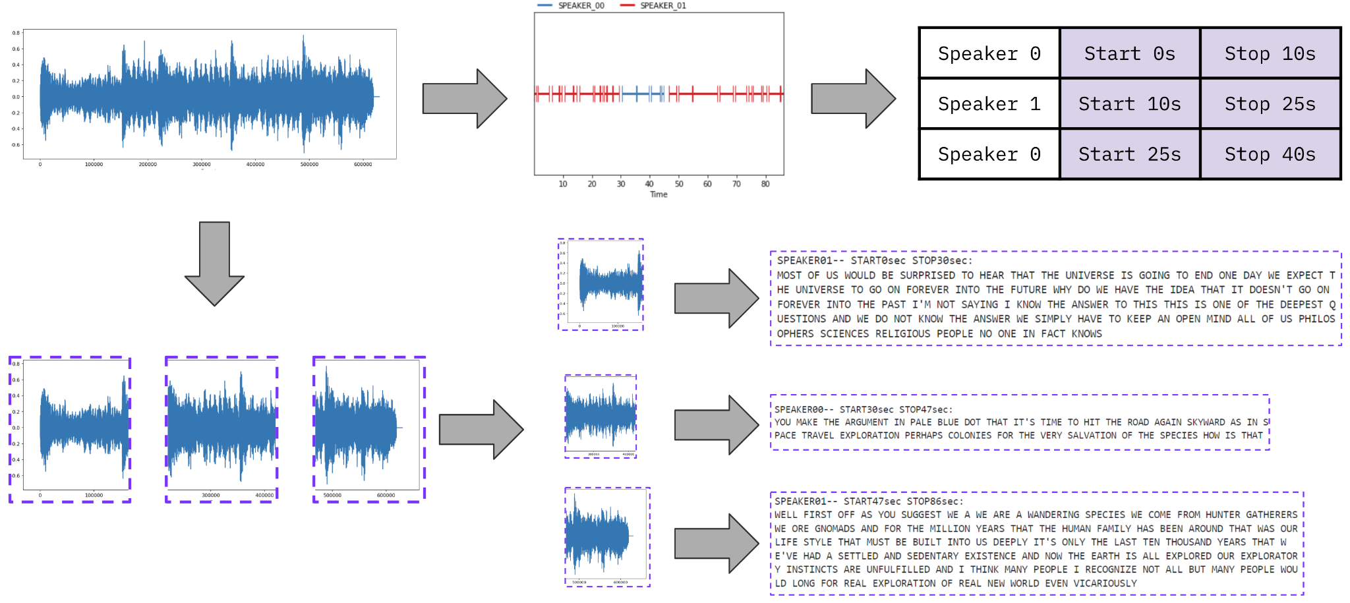
Diarisation and Transcription

Slide 104
Demo: Diarisation and Transcription
The Audio-Transcription Jupyter Notebook.

Slide 105
Audio Generation
Some of the latest advancements in audio based machine learning is the ability to generate audio.
An example is to generate speech from text.
Here we will explore how Hugging Face makes it easy to generate audio from an open-source text to speech model!
Note: We’ll be using the bark-small model from Suno, this is a small text-to-speech model with reasonable results.
It’s still over 1GB in size!

Slide 106
Demo: Audio Generation
The Audio-Generation Jupyter Notebook.

Slide 107
